Slide 1
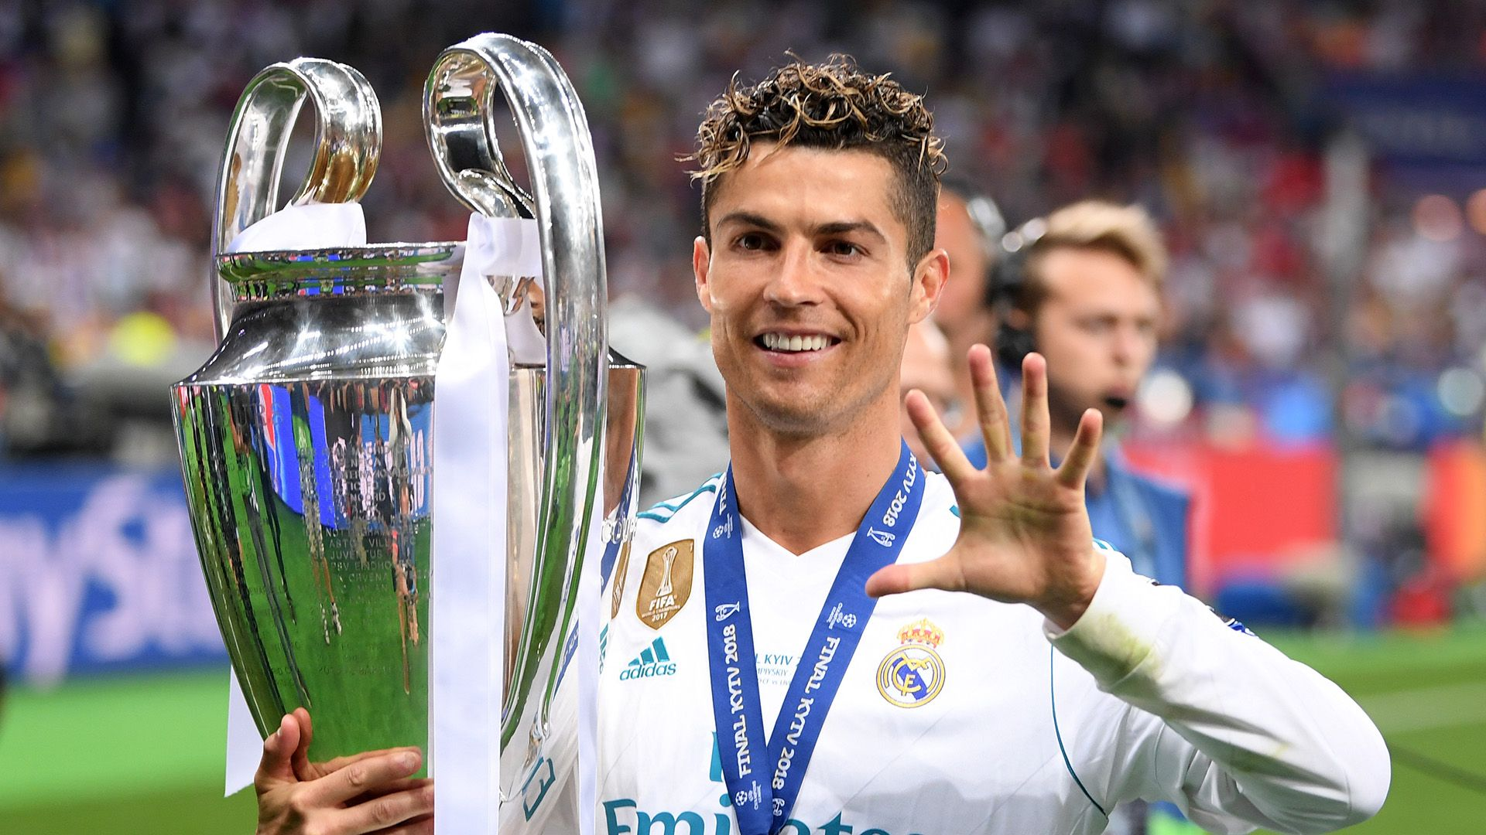
Ronaldo
Aadhvik

Slide 2
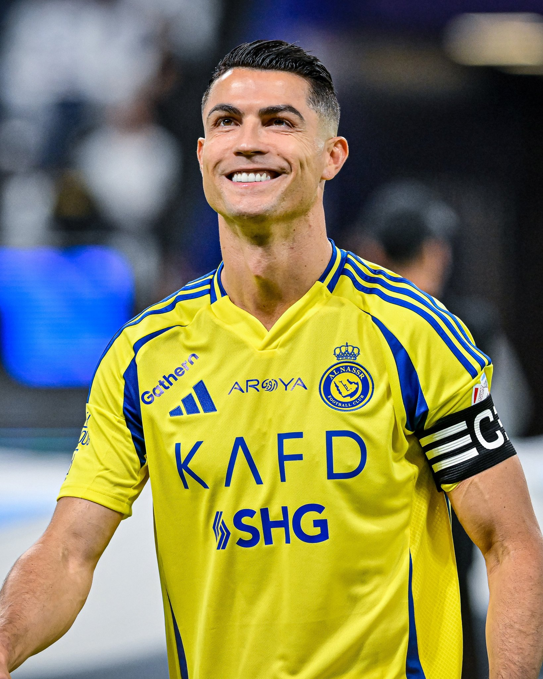
Hometown and Age
40 years
Portuguese island of Madeira

Slide 3
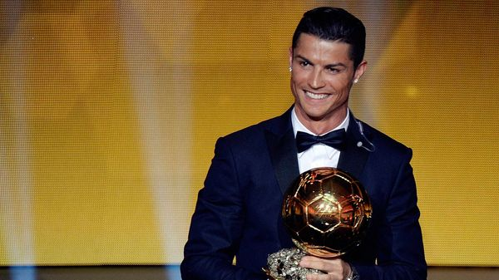
Profession
Soccer player legend
Model
Youtuber
Fashion entrepreneur

Slide 4
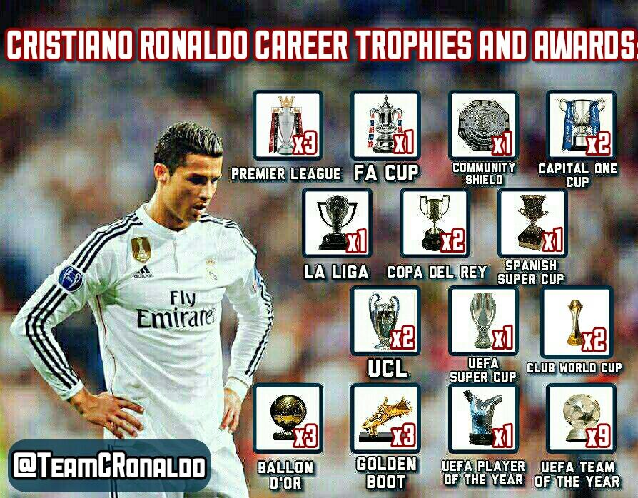
achievements
won five Ballon d'Or awards
a record three UEFA Men's Player of the Year Awards
European Golden Shoes

Slide 5
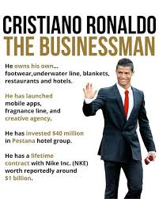
Entrepreneur type
lifestyle entrepreneur leveraged his global fame as a soccer
And played for lots of Manchester United, Real Madrid,Juventus, Al-Nassr.

Slide 6
inspires
It inspires me he was born on the same month and day and i play soccer

